Slide 1








GANPAT UNIVERSITY (ICT),Ahmedabad
LIBRARY MANAGEMENT SYSTEM
Presented by
RAHUL TIWARI (CS 42)
BRANCH:- CYBER SECURITY
SEM- 1
BATCH- 13
Guided by
PROF. RAJESH JHA
PROF. SONAM SINGH
ESFP-1
1

Slide 2
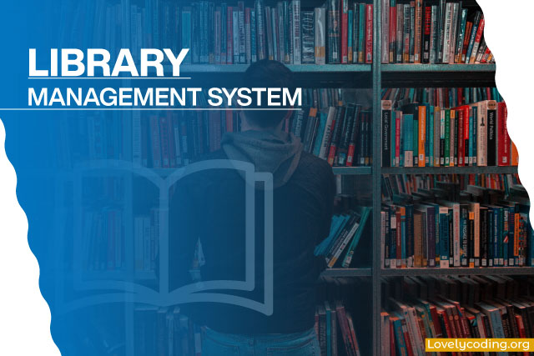
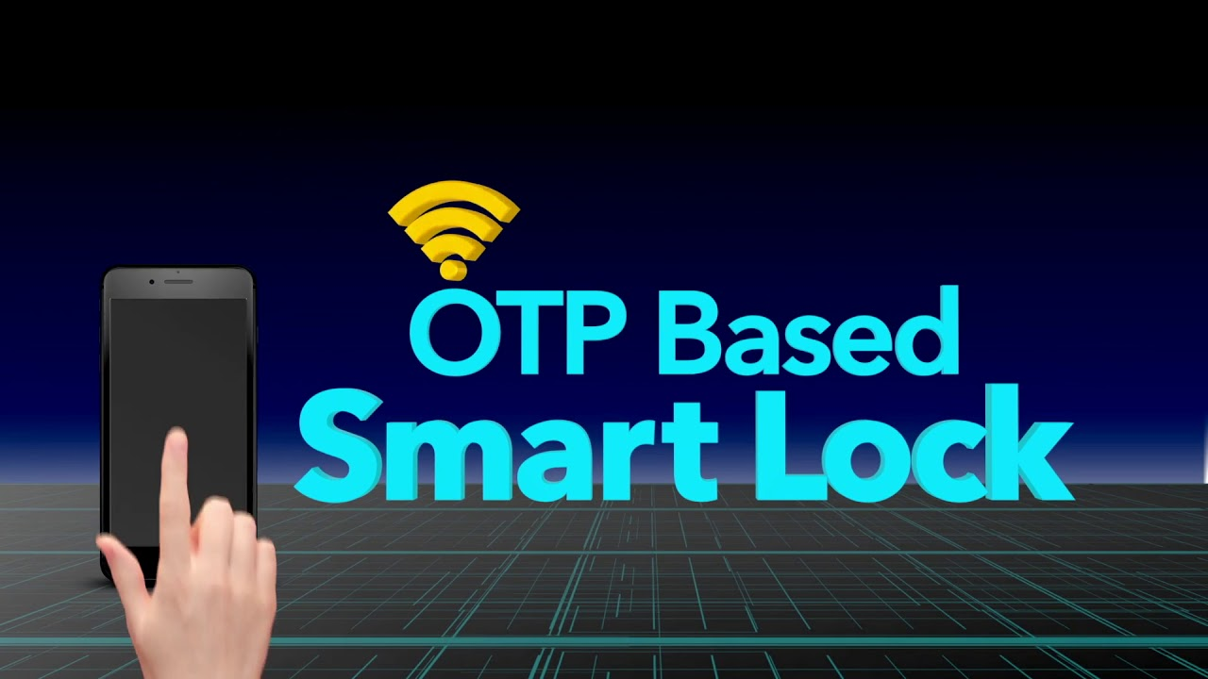
Content
1. INTRODUCTION
2. USES
3. OUTPUT
2

Slide 3

2. Introduction
It is defined as software that has been established to manage basic housekeeping function of a library. LMS helps to provide information on any book present in the library to the user as well as staff number. It also keeps a track of book published, given in return and added to the library.
A library management system is an example of an information system. An information system, whether it is computerised or not, is a system that represents objects in a physical system, for example, information resources in a library collection.
2

Slide 4

5. USE OF THIS PROJECT
1. LIBRARY MANAGEMENT SYSTEM IS USED TO KEEP A DATA OF EVERY BOOKS ADDED OR REMOVED
2. WE CAN TRACK A BOOK , IF SOME ONE HAS COLLECTED FROM LIBRARY TO STUDY
3.USING THIS SYSTEM NOT ANY BOOK WILL LOST OR MISPLACED AS
AS WE ARE KEEPING EACH AND EVERY RECORD SAVED IN THIS
2

Slide 5
17

